Slide 1
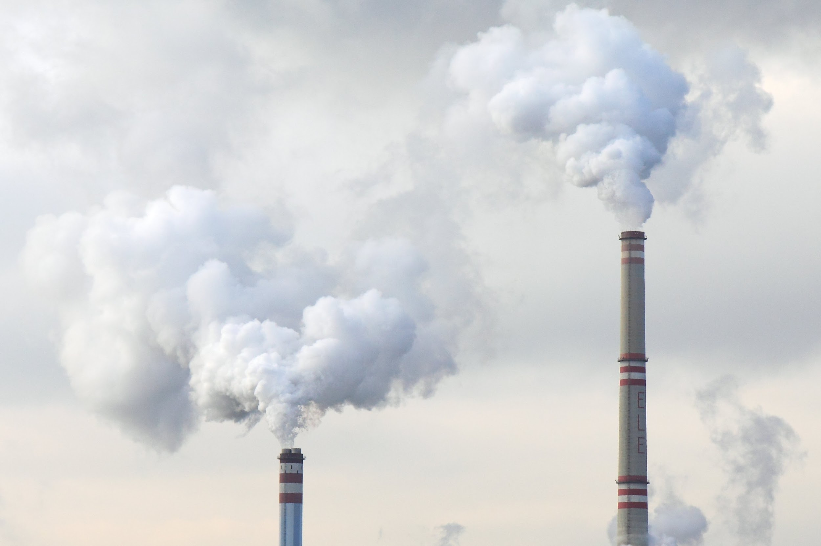
Melissa Calypso and Richard Peterson
Group 4B
The Gas Ceiling
Analysis of a Carbon Tax and Dividend Policy
Notes:
Hello, I’m Melissa Calypso. I, along with my colleague, Richard Peterson will provide an Analysis of a Carbon Tax and Dividend Policy.

Slide 2
Climate Change
According to the IPCC, climate change will affect U.S.¹:
Health
Climate
Agriculture
Infrastructure
Scientists attribute climate change to human activity.²
Greenhouse Gases
Carbon Dioxide
Methane
Nitrous Oxide
Water vapor
The Effects of Climate Change. (n.d.). Climate Change: Vital Signs of the Planet. Retrieved August 9, 2020, from https://climate.nasa.gov/effects
The Causes of Climate Change. (n.d.). Climate Change: Vital Signs of the Planet. Retrieved August 9, 2020, from https://climate.nasa.gov/causes
Notes:
According to the Intergovernmental Panel on Climate Change, climate change will affect the U.S. as it pertains to health, climate, agriculture and infrastructure.
Scientists attribute climate change to human activities such as the emission of greenhouse gases including Carbon Dioxide.
IPCC = Intergovernmental panel on climate change
Health: Food security, heat-related health risks in cities
Climate: Hurricanes, flooding, droughts, heat waves
Agriculture: Disrupted crop seasons, insect outbreaks
Infrastructure: Damage from flooding and rising sea levels

Slide 3
Midstream Carbon Tax
Tax would be levied on:
Petroleum-based fuels as it leaves the refinery or is sold for use.
Natural gas as it leaves local distribution centers.
Coal as it leaves the mine for combustion at power plants.
Tax levied at a mid-point in the supply chain where the fuel is converted to a product that can be combusted into carbon dioxide.
(Horowitz et al., 2017)
Notes:
To promote a reduction in emission of carbon dioxide, we recommend a midstream carbon tax that hits a midpoint in the fossil fuel supply change. The tax would be levied on…
Petroleum-based fuel as is leaves the refinery or is sold for use.
Natural gas as it leaves local distribution centers.
Coal as it leaves the mine for combustion at power plants.

Slide 4

Carbon Tax
Incrementally Increasing
Later emissions will do more damage than current emissions
Encourage innovation
Avoid needless expensive reductions in short-term
Reduce transition costs
(Marron & Toder, 2014)
Photo by Natalya Letunova on Unsplash
Notes:
We propose a carbon tax that incrementally increases over 10 years to hit a future carbon tax rate target. An incrementally increasing carbon tax will punish later emissions, which will do more damage than current emissions, encourage innovation in the energy industry, avoid needless expensive reductions in carbon dioxide emissions in the short term and reduce transition costs.

Slide 5
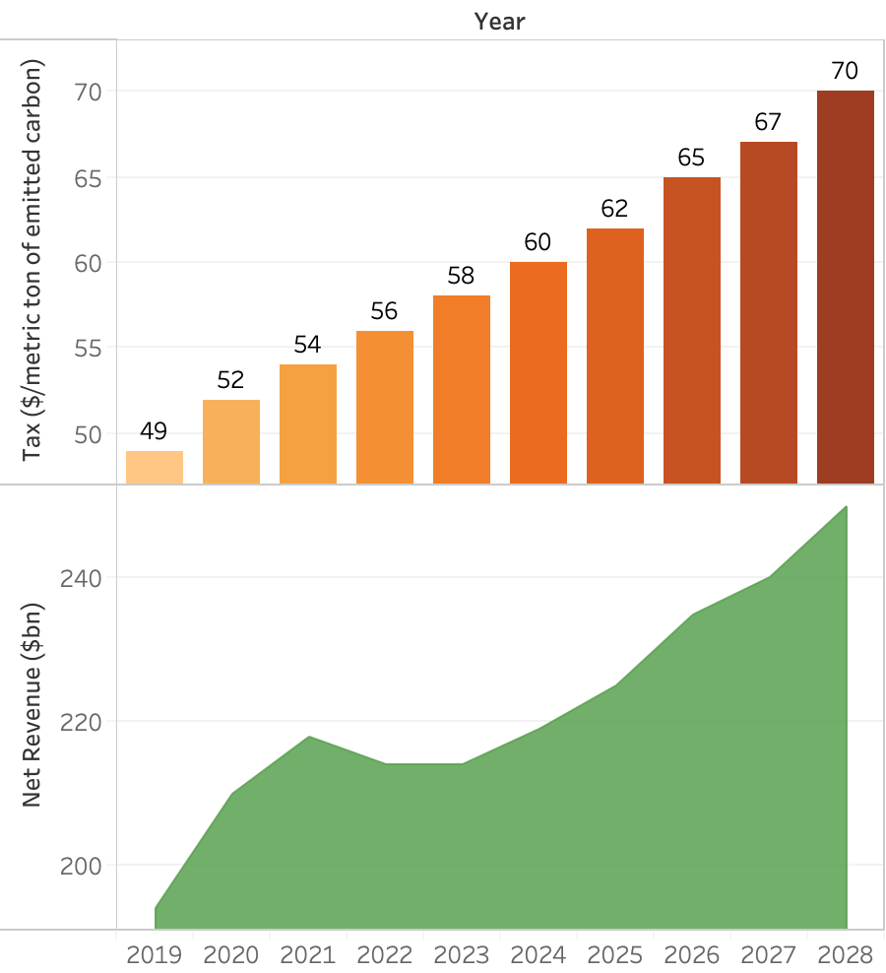
Carbon Tax
Calculation
Tax oil, natural gas, and coal based on carbon dioxide equivalent content.
Proxy for social cost
Incremental increase
Year 1: $49 / metric ton of carbon dioxide equivalent
Increasing up to $70 over 10 years.
(Horowitz et al., 2017)
Notes:
The carbon tax would be based on the carbon dioxide equivalent content of each fuel source. Essentially, how much carbon dioxide is emitted when the fuel is combusted. The tax would start at a fee of 49 dollars per metric ton of CO2 equivalent, and increase up to $70 dollars over 10 years.
The charts show Department of Treasury - Office of Tax analysis (Horowitz) calculations (using EPA greenhouse gas emissions calculator) for the 10-year revenue effects of a carbon tax that started at $49 per metric ton CO2-e on January 1, 2019.

Slide 6
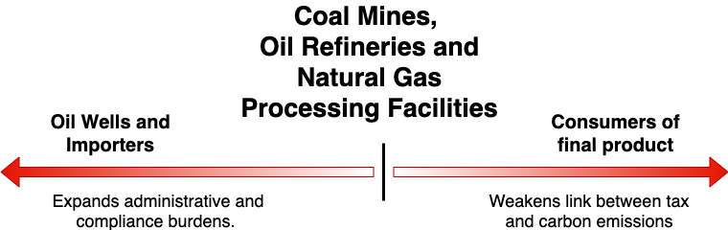
Midstream Carbon Tax Point
Who will pay for the tax?
(Marron & Toder, 2014)
Notes:
We recommend a midstream carbon tax point where the carbon content can be easily measured and the number of taxpayers is small. This occurs at coal mines, oil refineries, and processing facilities, where the amount of product leaving these production centers can be easily measured. Moving upstream to oil wells and importers adds administrative and compliance issues, such as trying to count the output of each oil well. Moving downstream to consumers of final products weakens the link between the tax and carbon emissions, as consumers have been shown to be independently rational in their choice of fossil fuels, but collectively inefficient in their understanding of how their personal consumption impacts the environment.

Slide 7
Carbon Dividend as a Tax Rebate
Who is eligible?
People who have or can easily get a Social Security number: U.S. citizens and legal permanent residents. The dividend increases each year as the tax increases.
In 2021, each adult will receive $570.
Children will receive half the adult dividend or $285.
Family of 4 will receives $1,710.
No cap - limits on dividends to families would be less equitable.
The carbon dividend would not be taxed as income.
Welfare eligibility
Earned Income Tax Credit
Notes:
To offset the impact of the carbon tax on consumer, we propose a carbon dividend in the form of a tax rebate. The rebate would apply to those who have or can easily get a Social Security number: U.S. citizens and legal permanent residents. The dividend would increases each year as the tax increases.
So, In 2021, each adult will receive $570. Each child will receive half the adult dividend or $285. And, a family of 4 will receive $1,710.
We determined that placing limits on dividends to families would be less equitable, since larger families emit more carbon.
Also, The carbon dividend would not be taxed as income. This would avoid any issues with Welfare eligibility and Earned Income Tax Credit

Slide 8
Policy Considerations
Carbon Tax Considerations
Equity
Impacts most those who produce and emit more carbon dioxide, it is fairly equitable.
Efficiency
Does not immediately mirror social cost, but is more politically attainable.
Administrative Simplicity
Easy to administer with defined units ability to track output.
Carbon Dividend Considerations
Equity
Tax Rebate to families ensures equity of tax distribution.
Efficiency
Reimburses consumers/families who emit more carbon and carry the most tax burden.
Administrative Simplicity
Tax rebate simple to administer through IRS.

Slide 9
References
Horowitz, J., Cronin, J.-A., Hawkins, H., Konda, L., & Yuskavage, A. (2017). Methodology for Analyzing a Carbon Tax. Office of Tax Analysis Working Paper, 115, 28.
Marron, D. B., & Toder, E. J. (2014). Tax policy issues in designing a carbon tax. American Economic Review, 104(5), 563–568.
Marron, D. B., & Maag, E. (2018). How to design carbon dividends (Links to an external site.) [Report]. Tax Policy Center.
The Effects of Climate Change. (n.d.). Climate Change: Vital Signs of the Planet. Retrieved August 9, 2020, from https://climate.nasa.gov/effects
The Causes of Climate Change. (n.d.). Climate Change: Vital Signs of the Planet. Retrieved August 9, 2020, from https://climate.nasa.gov/causes

Slide 10
Feedback 3A
Are there aspects of the group’s response that your team agrees with? Explain.
Are there aspects of the group’s response that your team disagrees with? Explain.
Were there parts of the group’s analysis that were missing that your group felt were important? Explain.
Was the presentation clear or unclear? Explain.
What improvements, if any, does your team suggest? Explain.

